Slide 1



Manufacturable & Robust Perovskite Solar
Devices for Space
Presenter: Kayshavi Bakshi
Contributors: Dr. Nicholas Rolston, Muzhi (Charles) Li
NASA Space Grant Symposium 4/20/2024
Notes:
Hi everyone, my name is Kay and I am senior in mechanical engineering at Arizona State University and I am here to discuss my research project of Improving the mechanical robustness of perovskite thin film solar devices

Slide 2
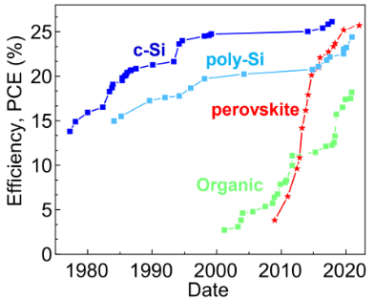
Introduction
Perovskite is: A thin film solar technology
Increasingly Efficient
Cheap and Abundant Earth Materials
Easily fabricated
Works in tandem applications
Light Weight
The Future!
Notes:
So what are perovskites? Perovskites are a thin film solar technology which generates energy from the sun. You may have seen it compared to silicon solar panels or other types of photovoltaic technologies. Perovskites are also a relatively new type of solar technology, having skyrocketed in efficiency in just over a decade. The graph on the right shows the power conversion efficiency increasing from 3% in 2009 to close to 26% in 2023. What this means is that Perovskites now have a very similar efficiency to Silicon solar panels. In addition, perovskites are made out of cheap and abundant earth materials, making them very low cost to manufacture. They are also easily fabricated and can work in tandem applications with other photovoltaic technologies. Lastly, perovskites are very light weight making them a great option for many different applications. In general, perovskites are the future of solar technology due to their high efficiency and low cost to manufacture. But the downside to perovskites is their mechanical fragility.

Slide 3
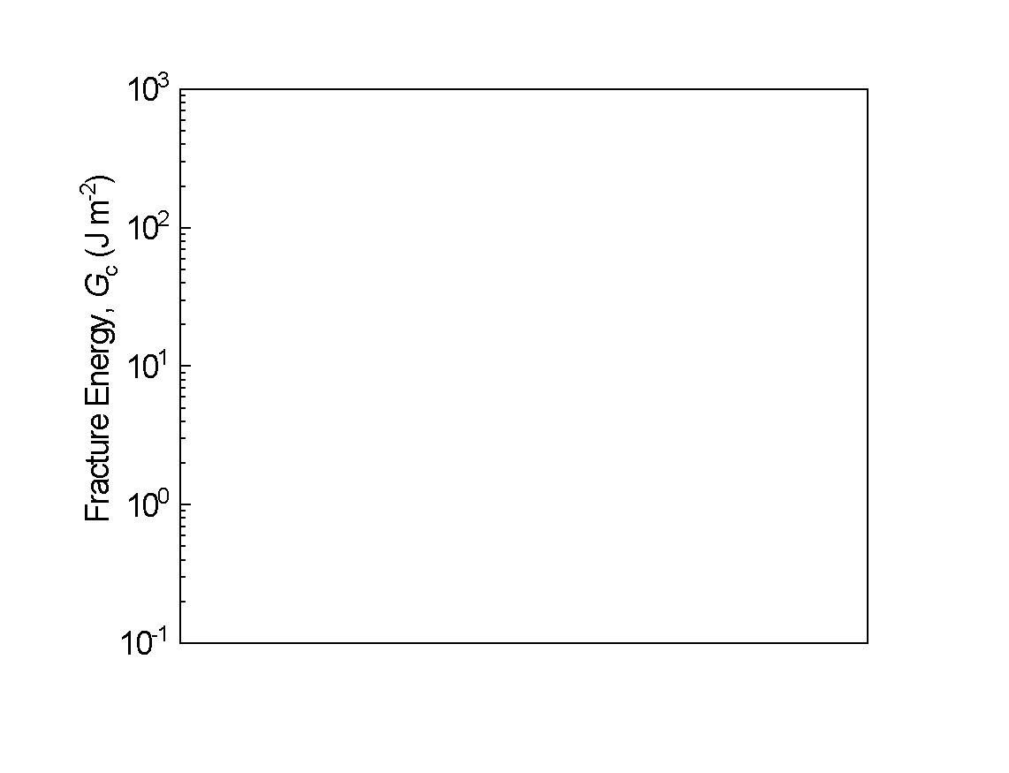
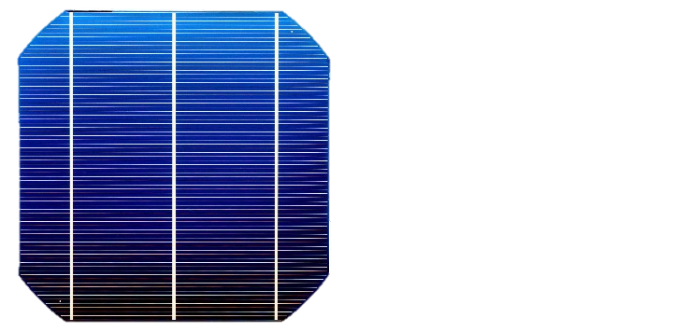
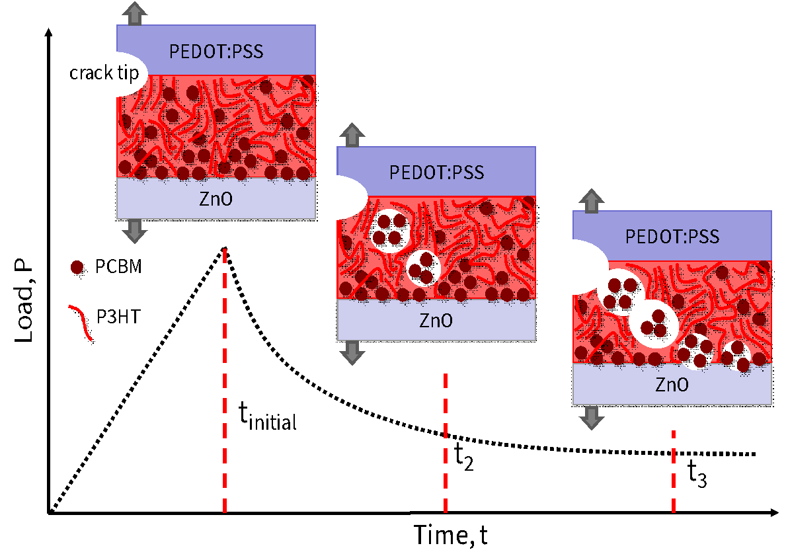
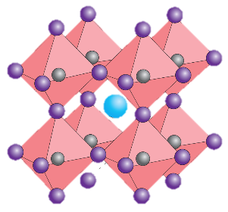
Mechanical Stability of Perovskite
Mechanically Durable to environmental conditions
c-Si
10 J/m² ≤ G_{c} ≤ 200 J/m²
Organic PV
G_{c} ~ 5 J/m²
Manufacturability Threshold
Susceptible to mechanical failure (very fragile!)
G_{c} ≤ 1.5 J/m²
Perovskite
Notes:
Silicon Solar Panels which are widely used in industrial and residential applications are more than 10x stronger than perovskite solar films. Due to their durable nature, silicon solar panels can last close to 25 years before being replaced. The graph shown here displays the Fracture Energy, Gc of the different solar technologies. The fracture energy coefficient is a representation of how durable the material is. You can see here that the the fracture energy of Perovskite is on average less than 1.5 J/m2 while Silicon solar panels range from 10 - 200 J/m2. This means that perovskite is very susceptible to mechanical failure and cannot last long term in the field. In fact in order to be manufactured for widespread use, most photovoltaic technologies need to reach a threshold of at least 5 J/m2. This begs the question, how can we make perovskite more durable for the long run?
The answer to this question might just be in your pantries at home! Who in the audience has cooked with corn starch or has corn starch in their pantry? Ok sweet, then you may know that adding corn starch to your sauces and food helps thicken them! And thats exactly what we did with perovskites to make them more durable!

Slide 4

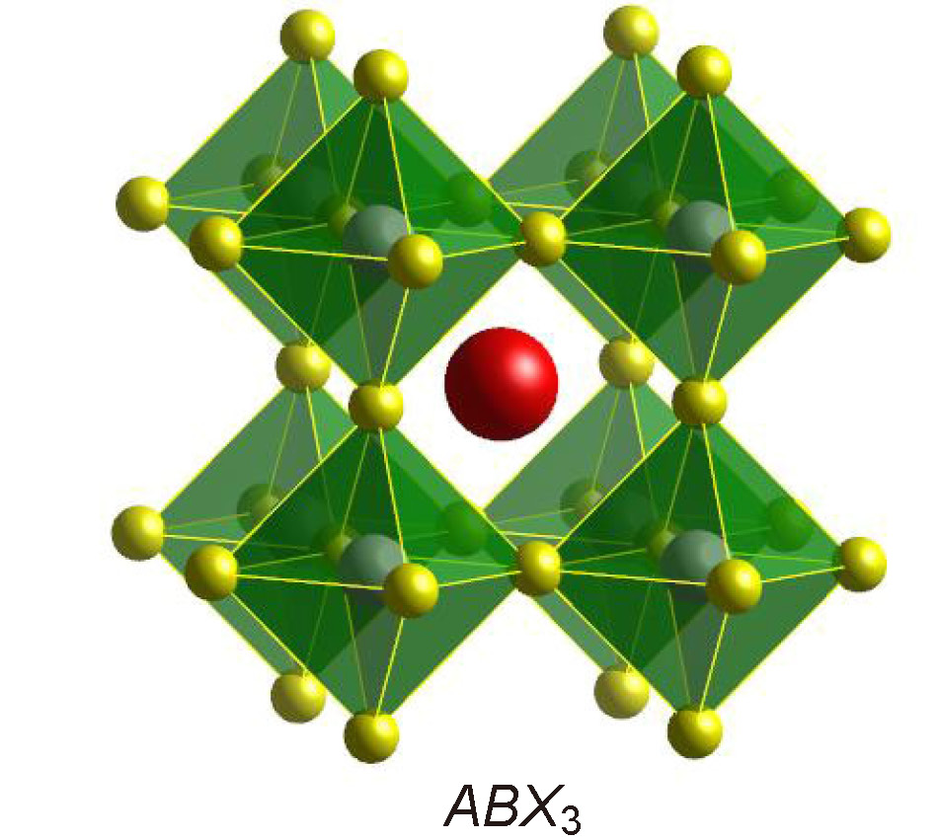
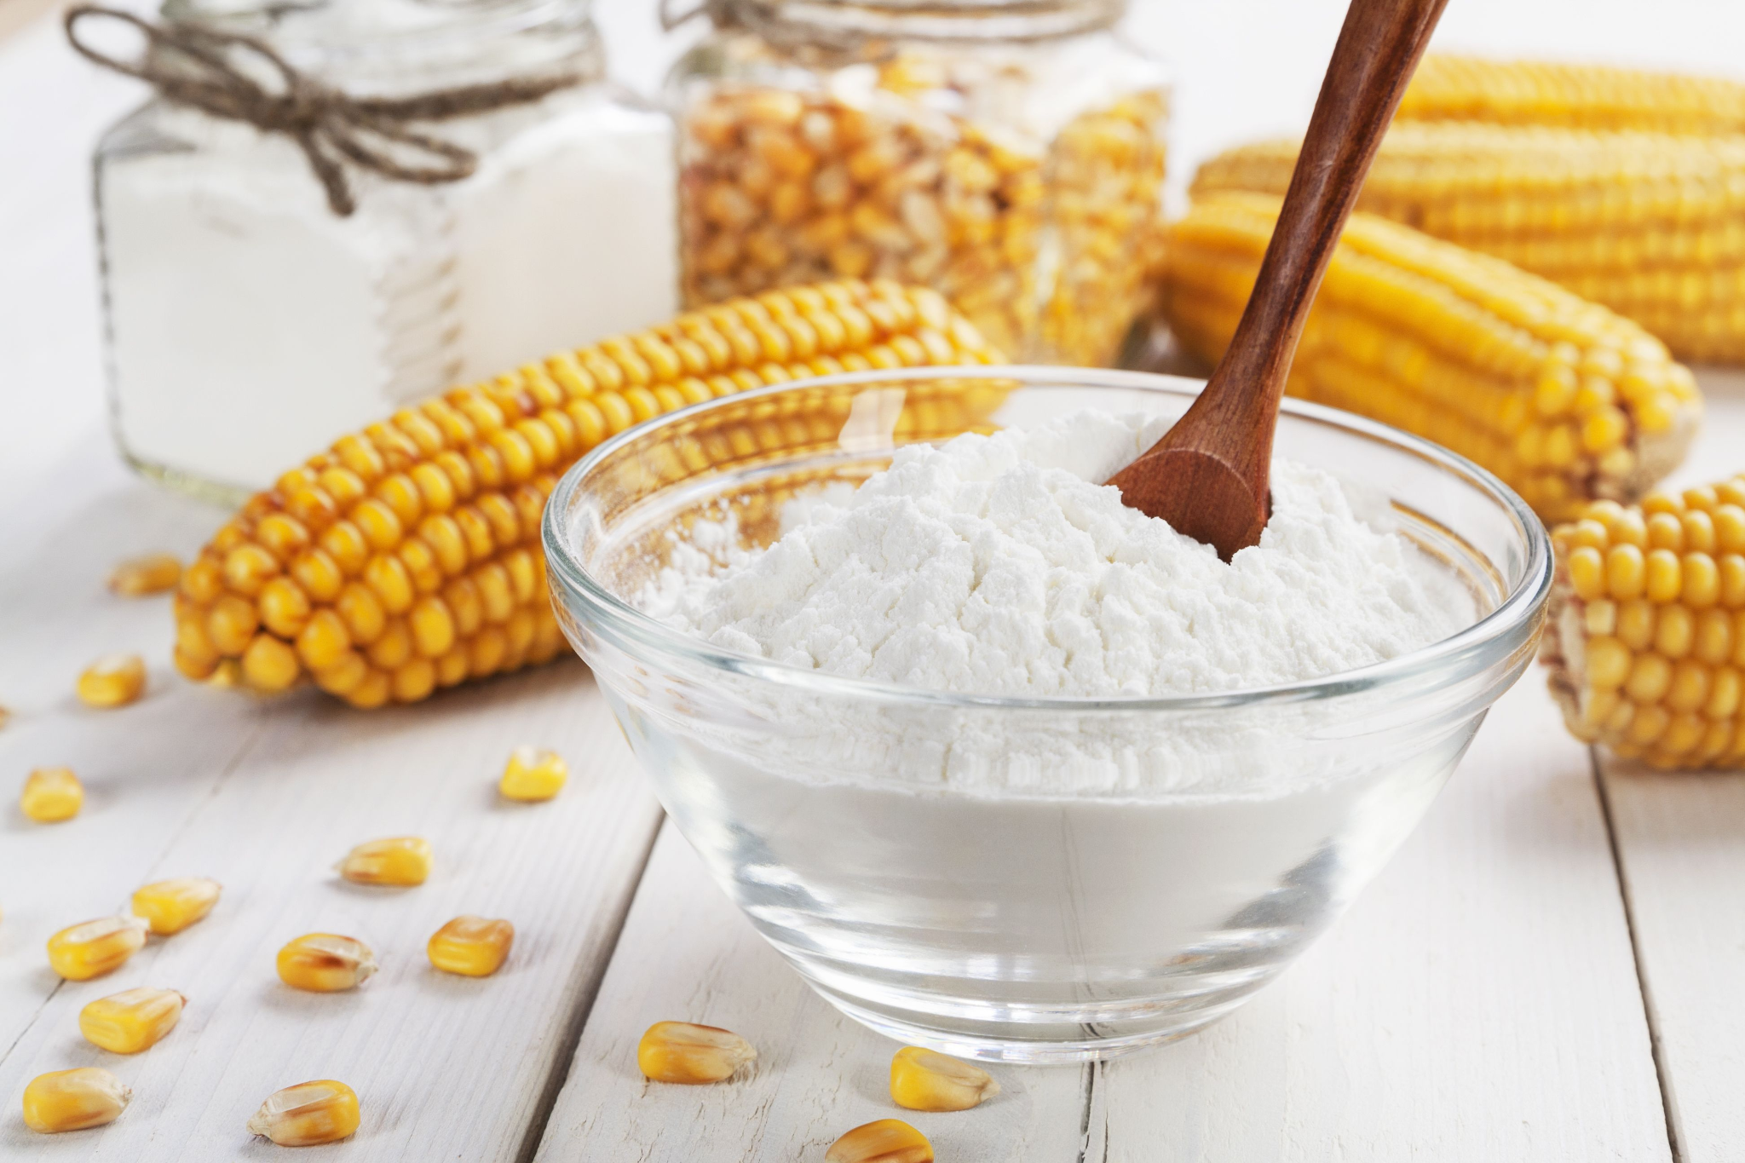
Research Objective
?
Cornstarch (5, 10, and 20% Weight Concentrations)
Perovskite
A
CH₃NH₃⁺
Methylammonium
Does adding Cornstarch to the Perovskite formula strengthen its fracture energy (Gc)?
B
Pb⁺²
Lead
X
I⁻
Iodine
Notes:
The answer is by adding additive to the perovskite structure. In particular my research looks to determine how adding cornstarch in 5, 10, and 20% concentrations affects the perovskite fracture energy. We chose corn starch as it is a low cost and highly available additive. Corn starch is primarily used in the culinary and food industry as a thickening agent, which makes it a great candidate for creating a more durable perovskite film.

Slide 5
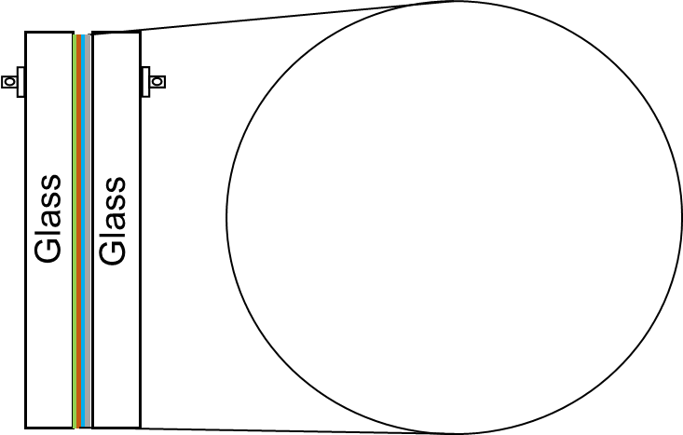
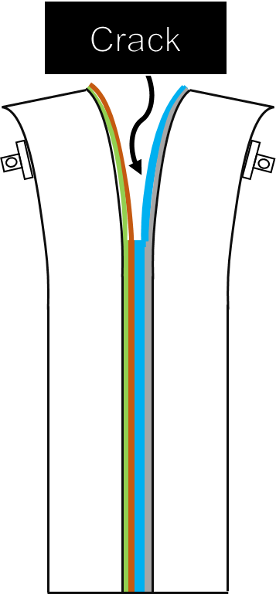
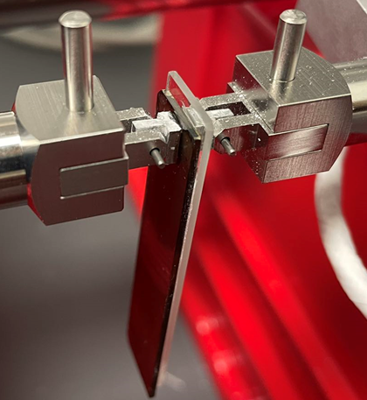
Double Cantilever Beam Methodology
Tensile Load
Notes:
In order to find the Fracture Energy of the perovskite films with starch, a double cantilever beam setup was used. This setup requires sandwiching the perovskite film in between two glass slides and propagating a crack on the film’s surface. A controlled crack is made throughout the sample by loading and unloading the film into tensile load in cycles. The system then calculates the fracture energy, which is the energy required to crack the perovskite. By controlling the crack, multiple fracture energy values can be calculated throughout the sample and then averaged.

Slide 6
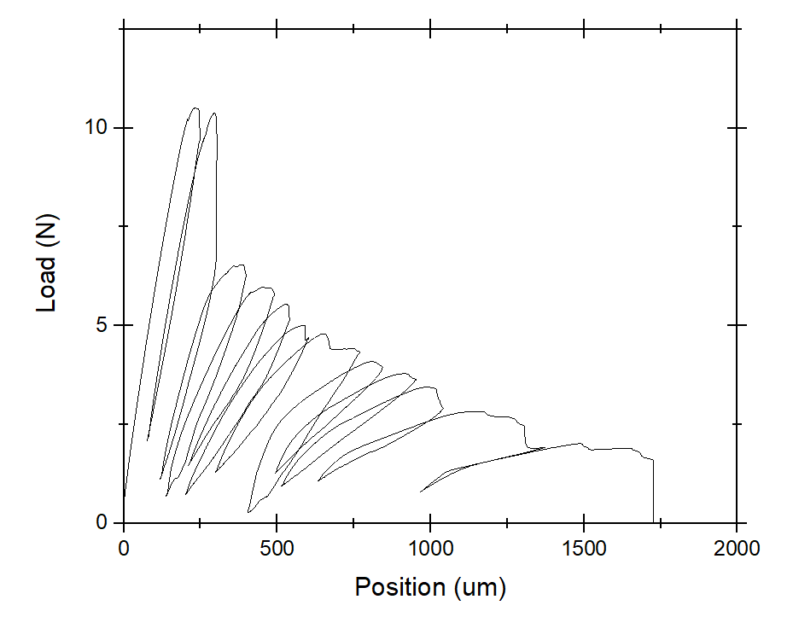
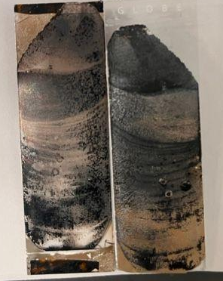
Test Results
10% Corn Starch
G_{c}: 4.483 ± 1.47 J/m²
Critical Loads, P_{c}
Used to calculate G_{c}
Notes:
This particular sample is a great example of propagating the crack to find the fracture energy. If you look at the sample picture on the left you can see multiple lines or rings, this a visualization of the crack slowly propagating throughout the sample. Each ring correlates to a peak on the load vs displacement graph. These peaks are the “critical loads” that are used to calculate the fracture energy throughout the sample. With this particular sample, there were 12 individual Fracture energy values that resulted in an average fracture value of 4.483 J/m^2 with a standard deviation of 1.47. This test was repeated on multiple samples ranging from 0 to 20% in corn starch concentration.

Slide 7
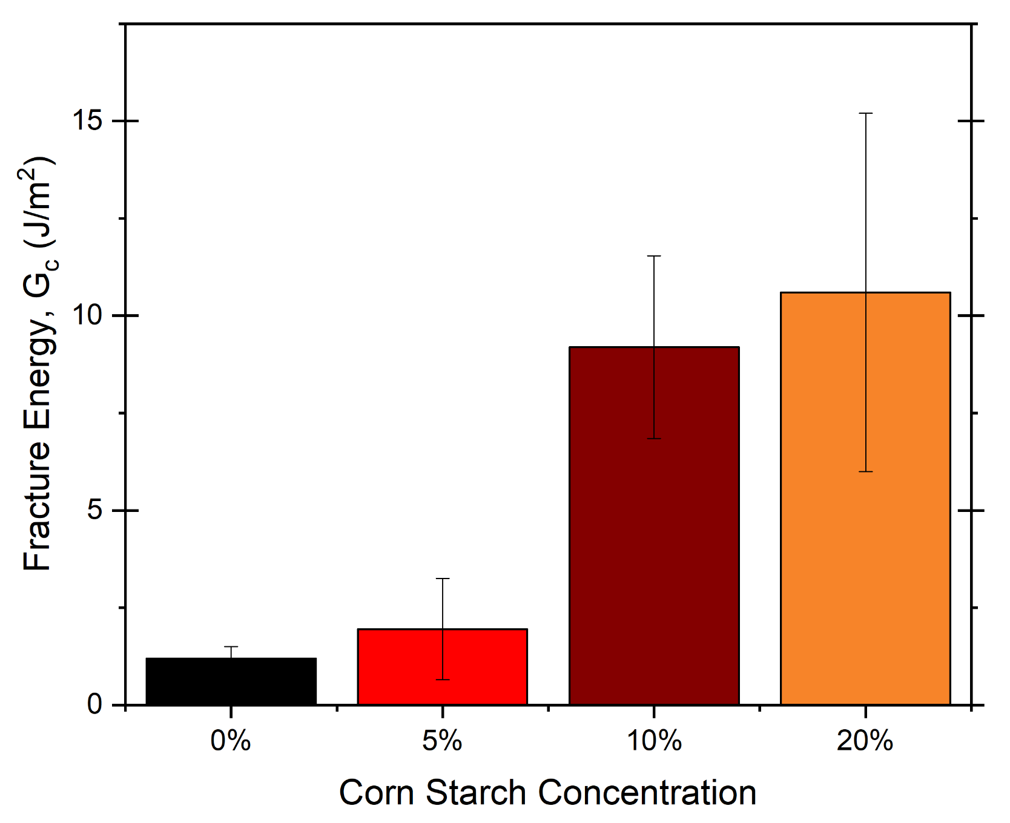
Fracture Results
G_{c} increases with Starch Concentration!
Perovskites become more durable and mechanically robust with the addition of corn starch
10% Cornstarch has the most optimal properties!
As it balances durability with film morphology and durability
Notes:
Ultimately it was found that the addition of corn starch increases the fracture energy of the perovskites making them more durable and mechanically robustness! The 10 and 20% cornstarch additives meet and exceed the 5 j/m^2 threshold that is required for wide spread manufacturing. Additional research has found that the 10% starch content films are the most optimal film due to them having a more uniform film morphology which results in optimized efficiency values. This research is one step closer to perovskites becoming a long lasting part of solar technology!

Slide 8
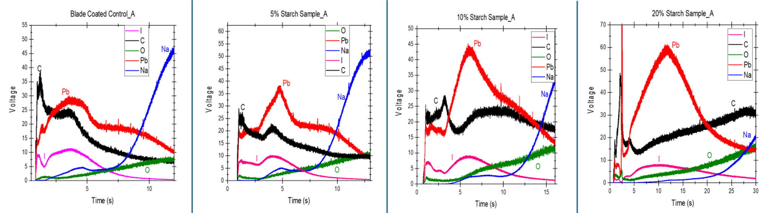
How does the film’s elemental composition change with starch?
Perovskite (MaPbI3) with cornstarch (C) on a glass substrate (Na)
Carbon becomes more uniform through the perovskite with more Starch Concentration
Starch is fully incorporated into each sample

Slide 9
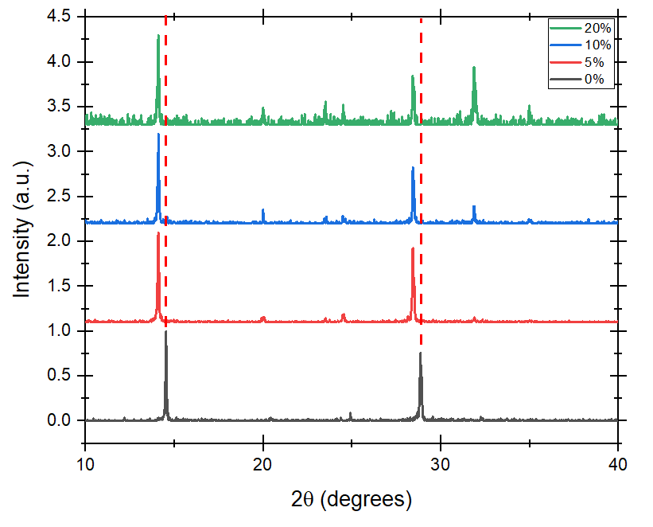
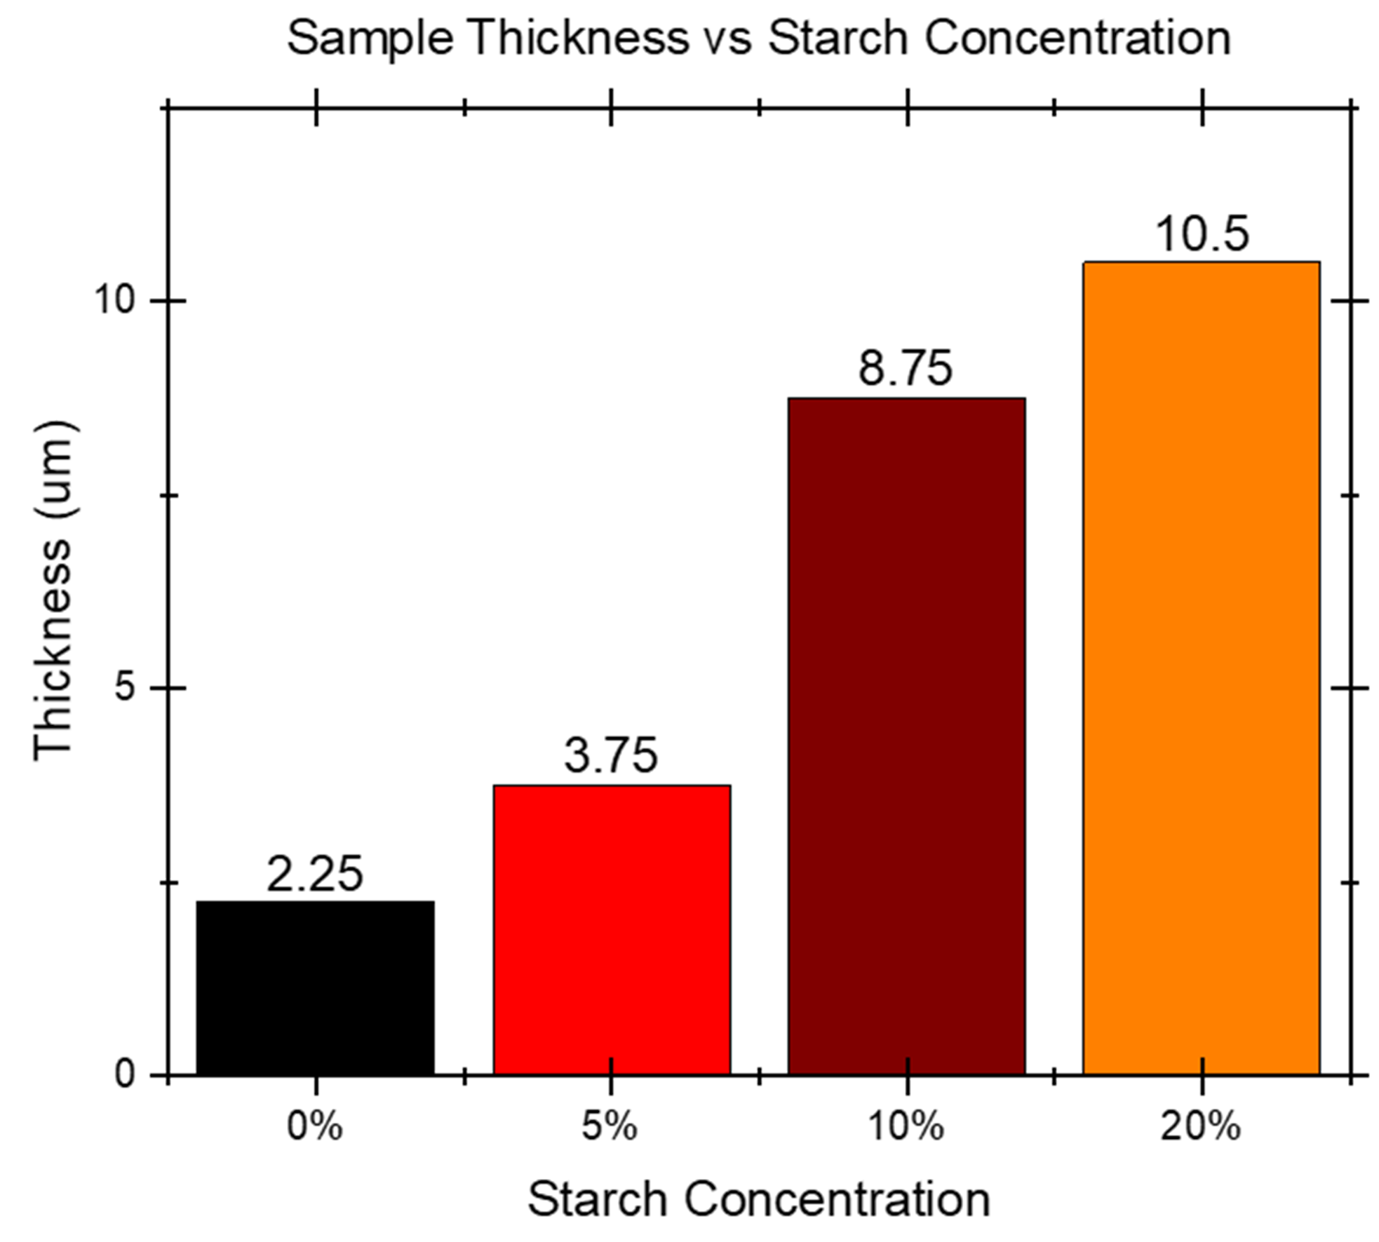
Does starch change other properties of the film?
𝛳 shift left caused by starch = lower angle = more spacing by perovskite = compressive stress
↑ Starch = ↑ Film Thickness
Notes:
Further tests have investigated subsequent properties of the different samples. XRD showed that the incorporation of starch results in internal tensile stress within the film, likely due to the increasing thicknesses of the samples. Photoluminescence showed that 20% and 10% starch concentrations had higher intensities suggesting that adding more starch could result in more efficient light excitation.

Slide 10
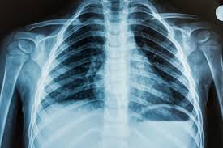
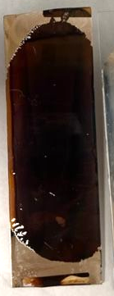
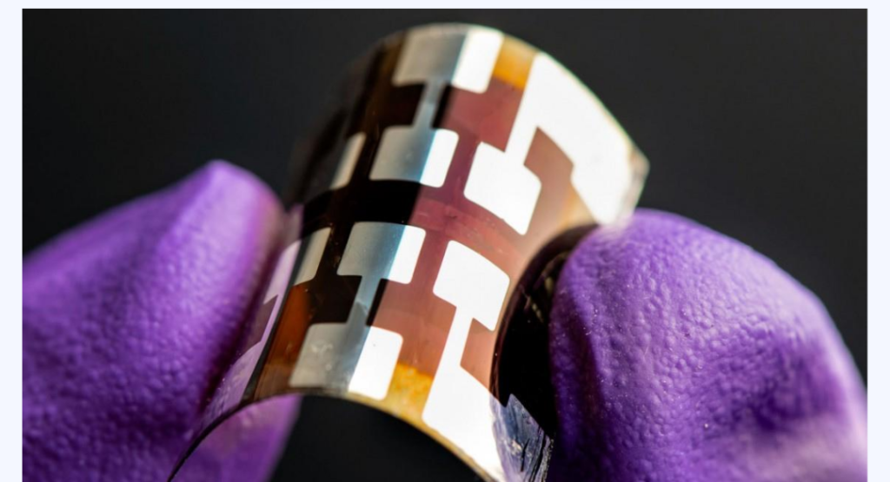

What can we do with a more robust, thick, and tunable film?
Notes:
The addition of starch to perovskite structure results in a more durable, thicker, and stable film. 10% Starch balances all of these properties the best, having a fracture energy that is significantly greater than the manufacturing threshold (5 J/m^2) and results in a smoother, more uniform film. The addition of starch does make these films too thick to be ideal for solar applications (1-2um). Thicker films are ideal for high energy detection applications; X-Rays, beta particles, alpha particles. The blade-coating technique used in this study displays the future for open-air fabrication and scalability. Furthermore, as perovskites are made from highly available earth materials, it is a cheap alternative! This research has developed inexpensive, scalable, durable, and tunable perovskite films that are ideal for various energy applications.

Slide 11
Thank you!
Questions?
Notes:
Thank you and I am happy to answer any questions you have

Slide 12
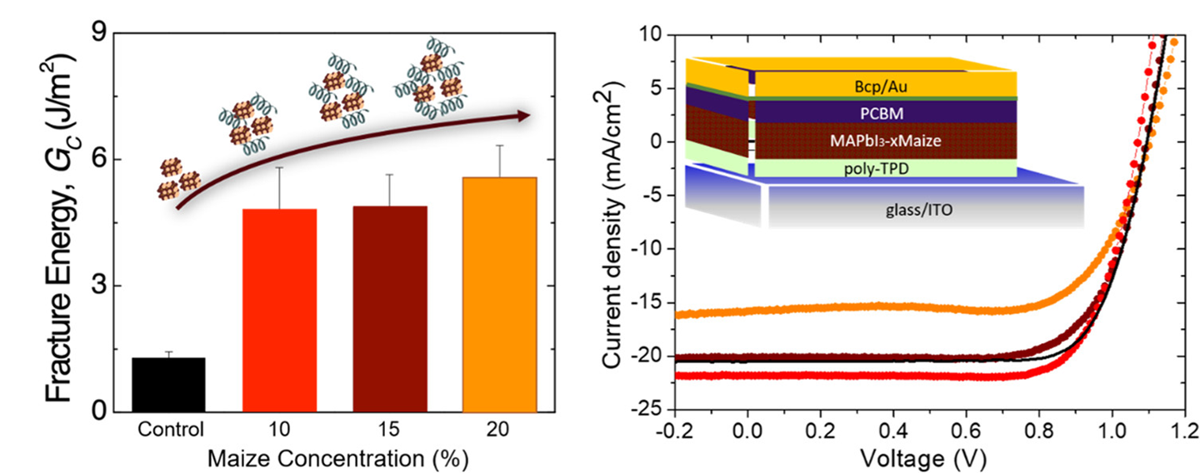

Starch Effect on PCE
A. Giuri, N.Rolston et al., ACS Applied Energy Materials, 2021
Notes:
The current density graph on the right displays the amount of electric current traveling per unit cross-section area of the films. The more negative the current density, the higher the current and power efficiency is. As seen here the red line represents the 10% starch concentration, and it has the highest current density. While the 20% concentration leads to a decrease in current density.

Slide 13
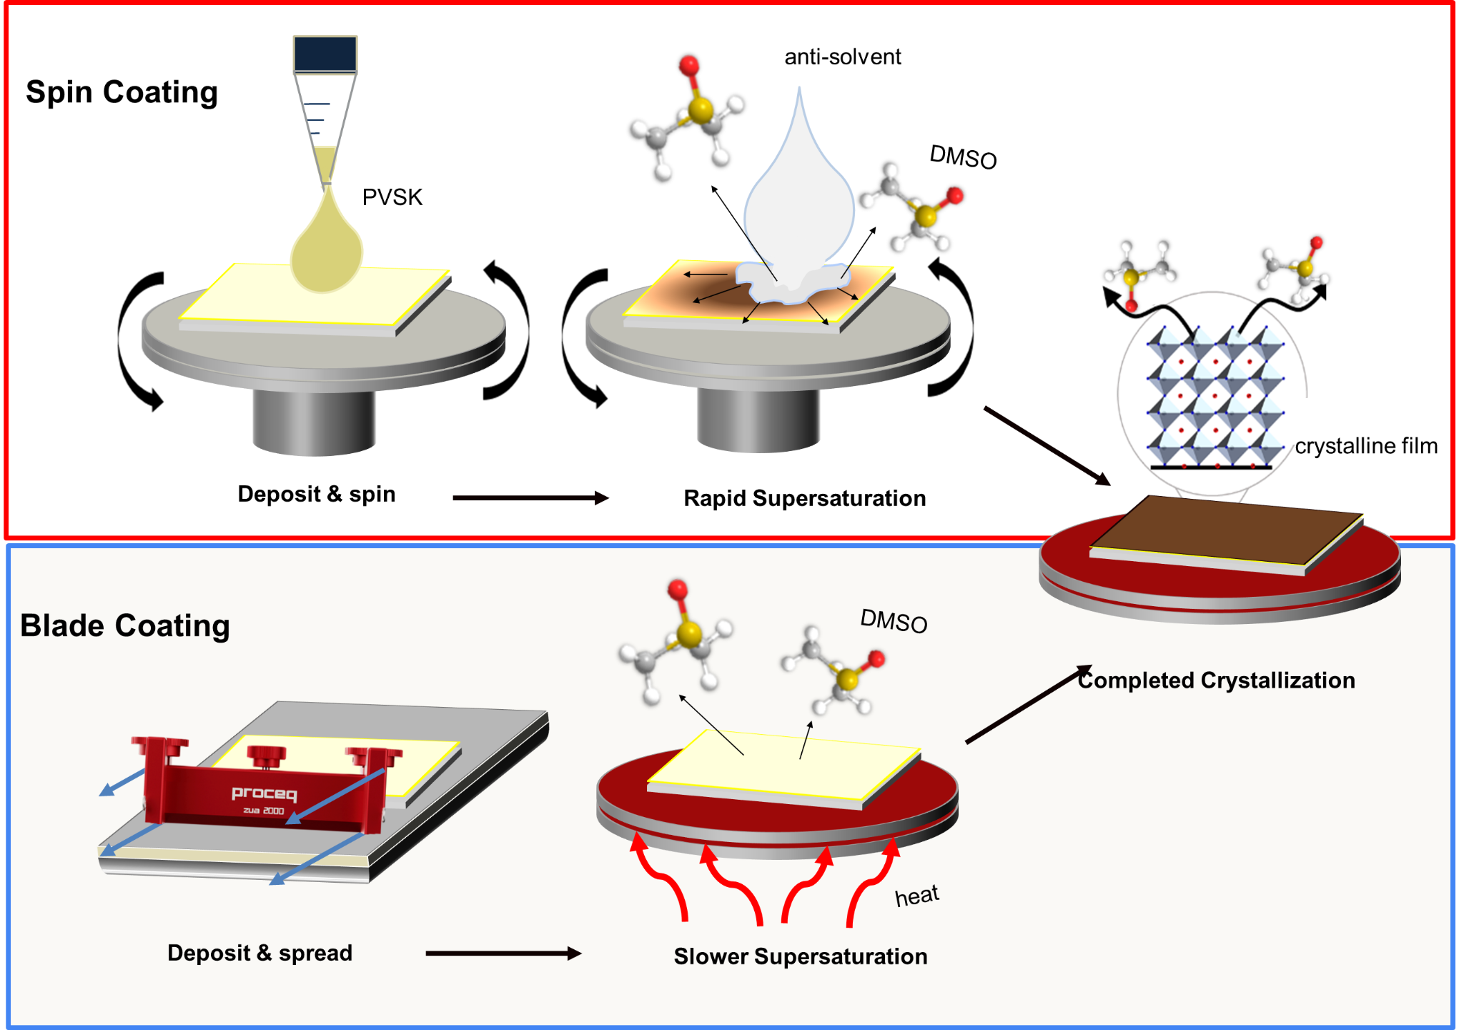
Processing Approach
Spin Coating
Precise
Small Scale
Blade Coating
Scalable
In Open Air

Slide 14

Film Layers
Epoxy
Ag - Protective
PMMA - Protective
Perovskite
ITO/NiO_{x} - Roughness

Slide 15
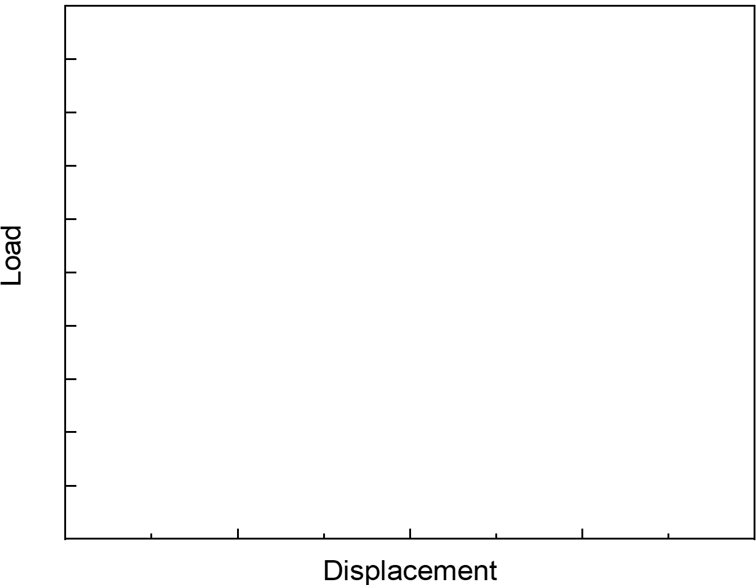
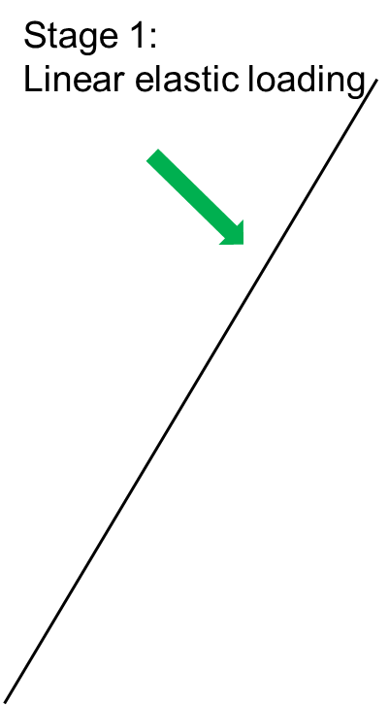
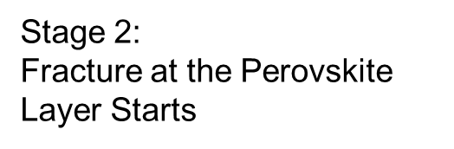

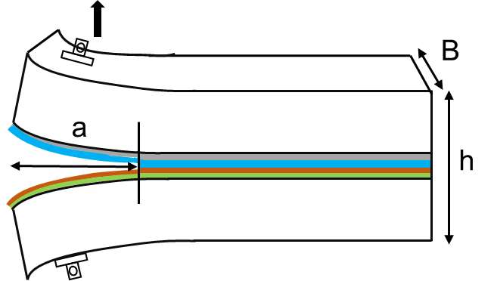

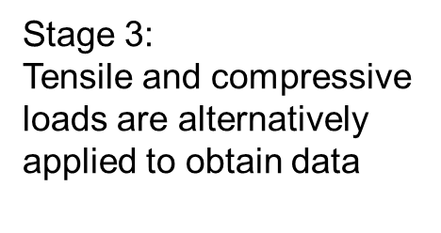

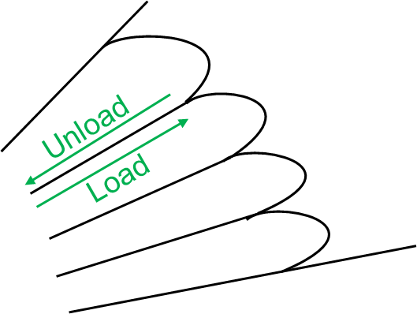
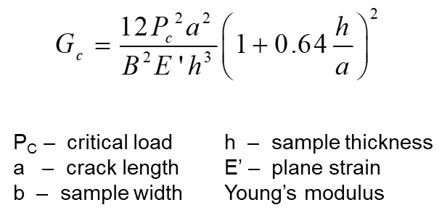
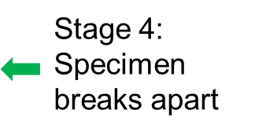
G_{c} Analysis
P
P
Critical Load- P_{c}

